Slide 1


GIS Training
Karisoke Research Center, Musanze, Rwanda, 2016
Presentation & Data Location: https://tinyurl.com/karisoke-GIS-2016

Slide 2
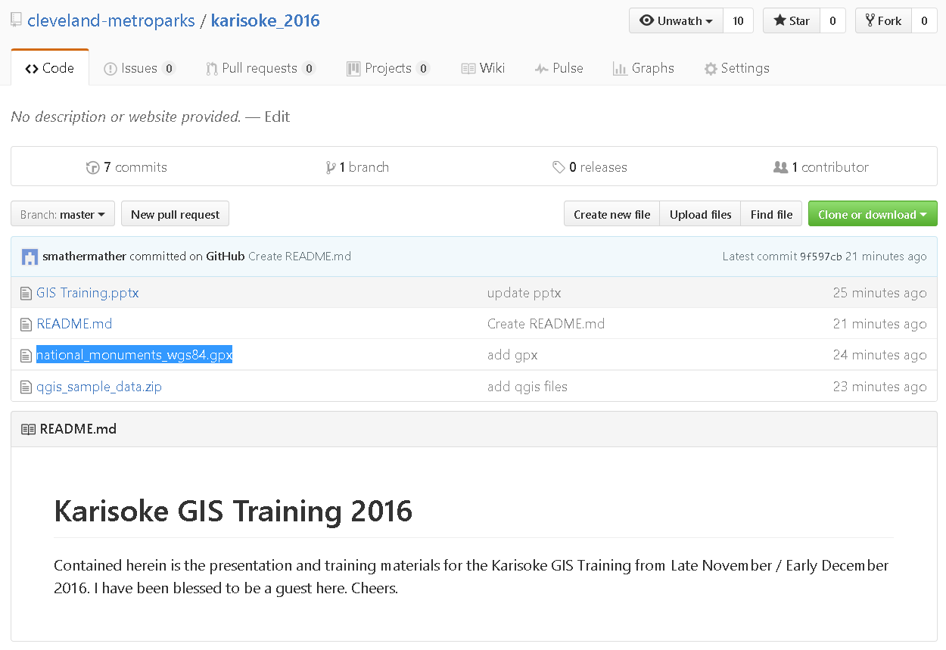

Slide 3
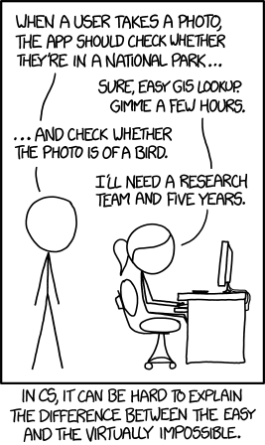

Slide 4
Take-away
Many things in GIS are easy
Some are moderately hard
Some are so hard as to be nearly impossible
It’s really hard to know the difference sometimes…

Slide 5
Who Am I?
Stephen V. Mather, GIS Manager Cleveland Metroparks
You can call me “Steve”
I am very jet-lagged. Please bear with me today.

Slide 6
Who Am I?
Stephen V. Mather, GIS Manager Cleveland Metroparks
You can call me “Steve”
Bachelor of Arts in Human Ecology
Foci (focus):
GIS
Biology
Music
Masters of Arts Geography and Planning
Foci:
Climatology
Remote Sensing
GIS

Slide 7
Who Am I?
3 field seasons in Forest Ecology
Foci:
Biophysics
Near-scale remote sensing
3 Years Remote Sensing Lab Byrd Polar Research Center
Glaciology
Radar Remote Sensing
9 Years GIS Manager, Cleveland Metroparks
Author of PostGIS Cookbook
Founder of OpenDroneMap software project

Slide 8
Operations + Philosophy
I believe in minimize *grunt* work
I believe in maximizing *thoughtful* work
(Though often the cost of minimizing grunt work exceeds the work itself.
GIS is a *collection* of tools roughly bound together
I'm an analyst at heart -- I want to maximize this time
I am happiest analyzing data, exploring data, automating analysis, and teaching others
I have a staff of 5 GIS personnel who are both brilliant and dutiful

Slide 9
QGIS
Desktop GIS similar to ESRI’s ArcMap
Fully Open Source
Excellent documentation:
http://docs.qgis.org/2.14/en/docs/user_manual/index.html
Easy-to-use
Runs on Linux, Windows, and Mac OS
Vibrant project with many contributors and users

Slide 10
Where did we begin?
Loading Data:
https://tinyurl.com/load-raster-and-vector-layers
Styling the Map:
https://tinyurl.com/styling-the-map
Zooming and Panning:
https://tinyurl.com/zooming-and-panning

Slide 11
Continuing…
Loading Vector Layers (revisited)
https://tinyurl.com/loading-vectors
Print Composer
https://tinyurl.com/print-sample-session
https://tinyurl.com/the-composer-manager
https://tinyurl.com/overview-composer

Slide 12
Finishing
Measuring:
https://tinyurl.com/general-tools-measuring
Selecting and Deselecting Elements
https://tinyurl.com/select-and-deselect
Identify Features
https://tinyurl.com/general-tools-identify
Spatial Bookmarks
https://tinyurl.com/spatial-bookmarks

Slide 13
Advanced
Loading GPS Data
https://tinyurl.com/loading-gps-data
Creating and digitizing data
Polygons
Populating the table
Populating manually
Field calculations

